Slide 1


Jarrell ISD Bond Planning Committee
Meeting 1
October 13, 2022

Slide 2
Welcome

Slide 3

Meeting Agenda
Welcome
Committee Overview
State of the District
  Demographic Report & Enrollment Trends
Recap of Facilities Committee
Group Feedback
Campus Tour*
*Optional

Slide 4
Committee Overview

Slide 5


Why a Committee?
You are here as a valuable voice in the district planning process.
You will study the potential needs of the district and work collectively to develop a plan and potential bond package that can be recommended to the Board of Trustees for their consideration.

Slide 6
Committee Overview
Over 50 citizens were invited to join this committee.
Committee Members were nominated to ensure a diverse
cross-section of the JISD community.
  Parents & Non-Parents
  Campus & District Staff
  Community & Business
  Mix of Backgrounds & Geographic Representation
Including varying perspectives from the entire community
is very important to the process.

Slide 7
Committee Charge
To help the district plan for the future, the Pre-Bond Committee is charged to:
Represent the entire community in the facility planning process
Assist the district in assessing and prioritizing the District’s current and long-term facility needs, including, but not limited to:
  District growth and capacity
  Building age, safety and condition
  Facility and program comparability
  Evolving educational delivery and programs

Slide 8
Committee Charge
Consider the educational needs of all students and align recommendations with the district’s mission, vision and goals
Consider the district’s current financial position and funding methods to develop a recommendation that is fiscally sound
Report their findings to the Jarrell ISD Board of Trustees that will include recommendations on how to proceed with the call of a bond election.

Slide 9
Overview of Process
YOU ARE
HERE
Assess Needs
at Existing
Facilities
Identify deficiencies
and inequities
at existing
campuses
Review
Financial
Data
Understand the financial capacity and implications
Study Demographics, Enrollment, & Visioning
Determine areas of overcapacity and needs for future growth
Convene
Committee
Create invaluable community input in the decision-making and recommend final plan to BoT
ASSESS
REVIEW
STUDY
CONVENE
Ongoing Responsibilities of JISD + included input from first two committees.

Slide 10
Overview of Process
District Educates Voters on the Proposal
After the Board’s call, it’s the school district’s role to communicate facts about the bond
Voters Consider Proposition(s)
School bond propositions must be held with the general elections in May or November
Voters Approve
Bond Election
A majority of voters voting in favor of the proposition(s) gives the Board authority to
sell bonds
District Sells Bonds to Investors
District issues bond sales in increments over time to match the schedule of project design and construction
EDUCATE
VOTE
APPROVE
SELL
Shared Responsibility

Slide 11
Overview of Process
Project Design
Project design is a multifaceted process that begins conceptual and concludes with construction documents
CONSTRUCT
Board Levies
I&S Tax Rate
The Interest & Sinking tax rate (set annually) is levied to make annual debt payments
Projects Bid
Projects are bid in the competitive market to select a contractor and get the best value for the District
Project Construction
Construction takes approx. 12-14 mos. for an elementary and
24-28 mos. for a
high school
LEVY
DESIGN
BID

Slide 12
Overview of Process
Beginning tonight, the committee will engage in discussion around the following topics:
Findings from Previous Committees
Demographic Report and Enrollment Projections
School Finance (state and local)
Bonding Capacity & Impact of Potential Bond
Needs, Potential Solutions & Cost Analysis
  New Construction
  Renovations
  Expansions
  Special Programs/Facilities
  Safety & Security
  Technology
  Transportation
  Land

Slide 13
Schedule
Meeting | Date | Time | Location
Meeting 1 | Tonight | 5:30 | Igo Elementary School
Meeting 2 | Thursday, Nov. 10 | 5:30 | Jarrell Middle School
Meeting 3 | Thursday, Dec. 8 | 5:30 | Jarrell High School
Meeting 4 | Thursday, Jan. 12 | 5:30 | Jarrell Elementary School
 | *Wednesday, Jan. 18 |  | *Potential Recommendation Presentation to Board of Trustees
 | Friday, Feb. 17 |  | Deadline to Call a May 2023 Election

Slide 14
Committee Guidelines
Each member will do their best to represent the entire community in the bond planning process.
All voices and opinions will be heard and respected.
The educational needs of all students will be the ultimate consideration.
The Committee’s role is – along with the Superintendent and staff - to provide recommendations and the Board of Trustees will ultimately determine the timing, structure and content of any potential bond issue.

Slide 15
Meeting Norms
Do your best to attend all meetings – content and decisions will build from meeting to meeting
Start and end on time – 1.5 hours each
Respect all opinions
Everyone participates – no one dominates
Take personal breaks as needed
Use Committee’s definition of consensus for
decision-making

Slide 16
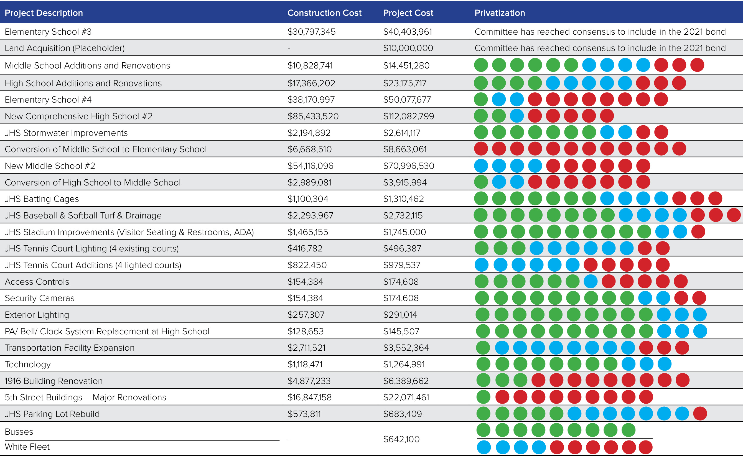
Example from 2021 Facilities Planning Committee

Slide 17
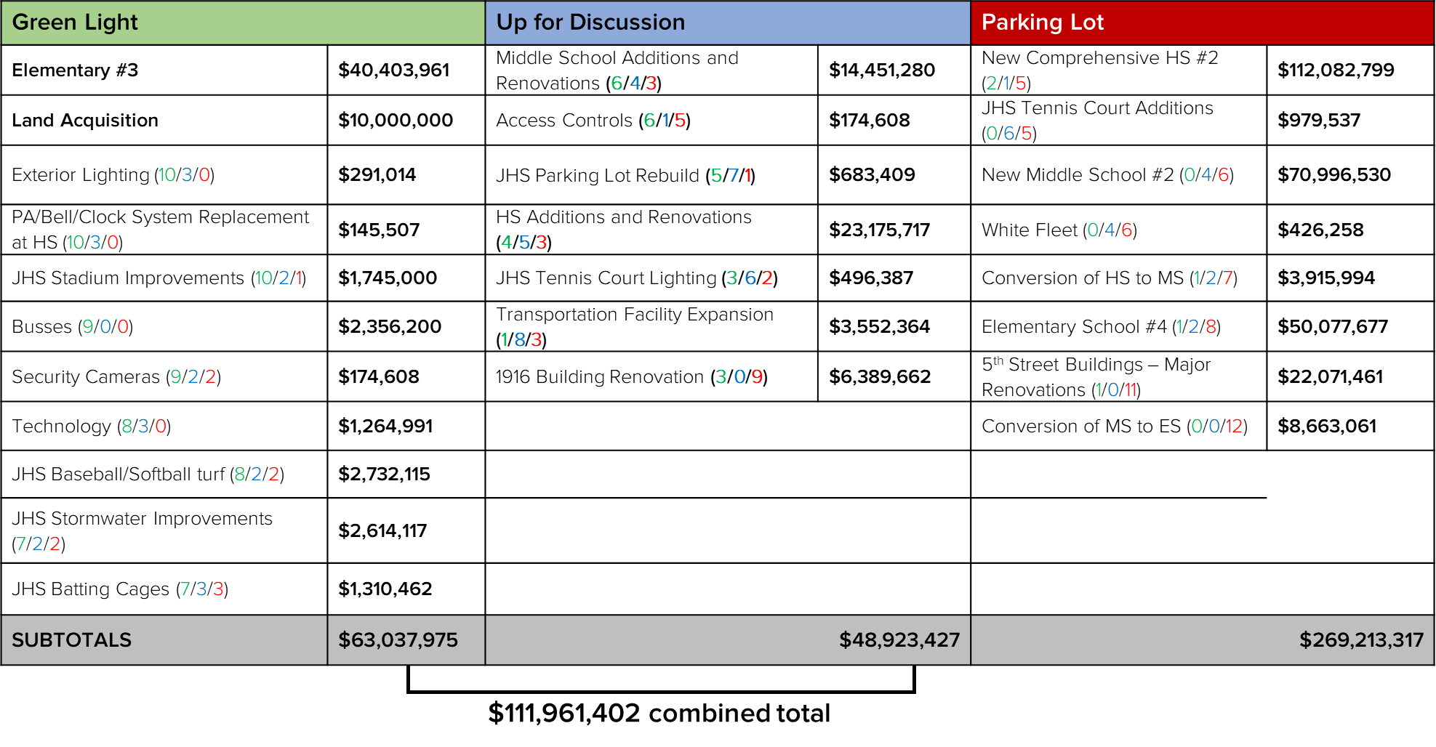

Slide 18
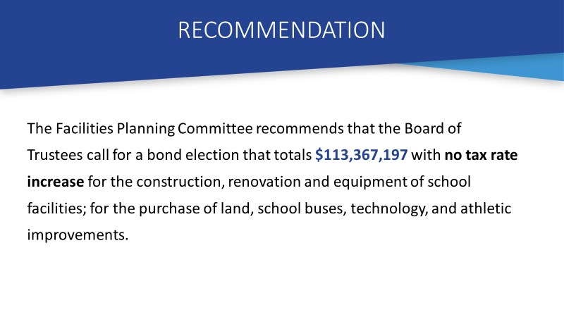

Slide 19
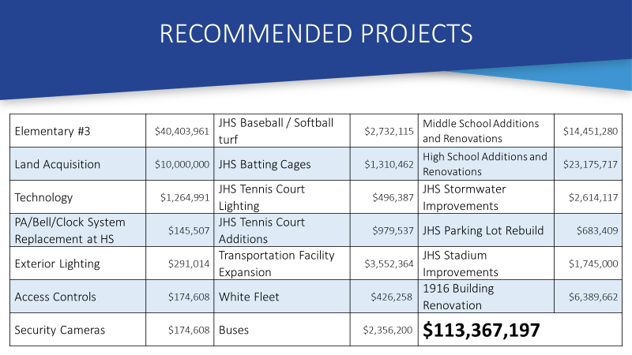

Slide 20
State of the District

Slide 21
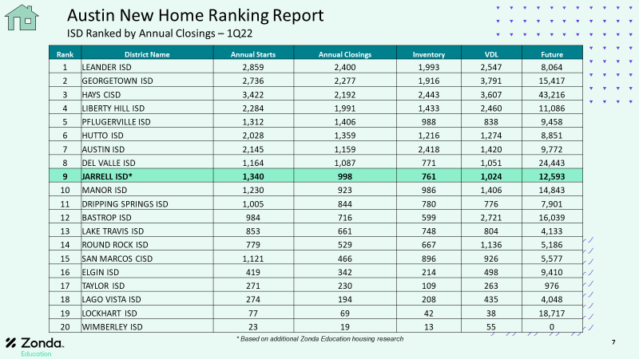

Slide 22
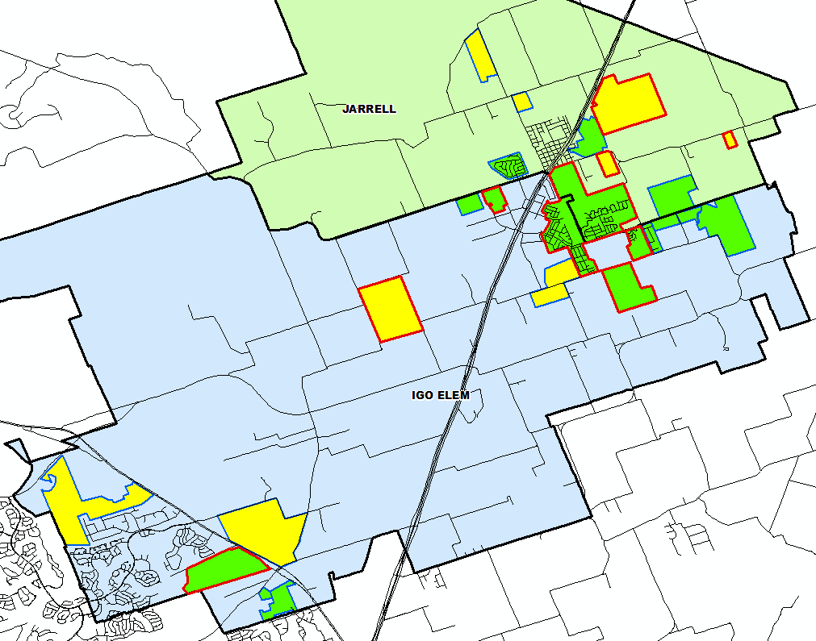
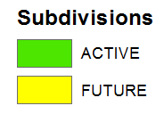

District Housing Overview
The district has 15 actively building subdivisions
Within JISD there are 10 future subdivisions
Groundwork is underway on nearly 1,250 lots within 7 subdivisions

Slide 23
Ten Year Forecast by Grade Level
Year (Oct.) | EE | PK | K | 1st | 2nd | 3rd | 4th | 5th | 6th | 7th | 8th | 9th | 10th | 11th | 12th | Total | Total Growth | % Growth
2017/18 | 10 | 80 | 133 | 146 | 133 | 127 | 131 | 120 | 119 | 135 | 108 | 124 | 124 | 113 | 100 | 1,703
2018/19 | 13 | 90 | 142 | 153 | 154 | 138 | 144 | 146 | 141 | 129 | 142 | 136 | 126 | 122 | 121 | 1,897 | 194 | 11.4%
2019/20 | 5 | 108 | 174 | 164 | 171 | 161 | 168 | 159 | 159 | 169 | 143 | 172 | 125 | 120 | 104 | 2,102 | 205 | 10.8%
2020/21 | 4 | 87 | 182 | 198 | 181 | 171 | 170 | 184 | 167 | 170 | 176 | 183 | 177 | 137 | 118 | 2,305 | 203 | 9.7%
2021/22 | 6 | 151 | 224 | 241 | 244 | 222 | 219 | 209 | 208 | 209 | 193 | 221 | 192 | 205 | 141 | 2,885 | 580 | 25.2%
2022/23 | 21 | 200 | 277 | 276 | 292 | 301 | 270 | 270 | 259 | 262 | 255 | 259 | 232 | 221 | 209 | 3,604 | 719 | 24.9%
2023/24 | 23 | 235 | 336 | 338 | 325 | 350 | 361 | 326 | 329 | 316 | 314 | 332 | 272 | 248 | 221 | 4,326 | 722 | 20.0%
2024/25 | 23 | 265 | 381 | 395 | 382 | 368 | 394 | 419 | 394 | 401 | 379 | 408 | 340 | 269 | 243 | 5,061 | 735 | 17.0%
2025/26 | 23 | 280 | 440 | 445 | 461 | 442 | 426 | 458 | 457 | 450 | 431 | 498 | 418 | 337 | 264 | 5,830 | 769 | 15.2%
2026/27 | 23 | 310 | 498 | 519 | 503 | 521 | 507 | 495 | 499 | 503 | 488 | 562 | 510 | 414 | 330 | 6,682 | 852 | 14.6%
2027/28 | 23 | 350 | 555 | 583 | 582 | 561 | 589 | 573 | 532 | 544 | 545 | 586 | 551 | 505 | 406 | 7,485 | 803 | 12.0%
2028/29 | 23 | 370 | 611 | 643 | 637 | 631 | 617 | 648 | 616 | 580 | 588 | 693 | 604 | 545 | 495 | 8,301 | 816 | 10.9%
2029/30 | 23 | 400 | 656 | 703 | 691 | 692 | 694 | 679 | 697 | 671 | 628 | 740 | 701 | 598 | 534 | 9,107 | 806 | 9.7%
2030/31 | 23 | 400 | 705 | 739 | 755 | 750 | 761 | 764 | 730 | 760 | 726 | 781 | 745 | 694 | 586 | 9,919 | 812 | 8.9%
2031/32 | 23 | 400 | 742 | 794 | 779 | 820 | 825 | 837 | 821 | 796 | 823 | 913 | 794 | 738 | 680 | 10,785 | 866 | 8.7%
Yellow box = largest grade per year
Green box = second largest grade per year

Slide 24
Ten Year Forecast by Campus
 |  |  | Fall | ENROLLMENT PROJECTIONS
Campus | Capacity | 2020/21 | 2021/22 | 2022/23 | 2023/24 | 2024/25 | 2025/26 | 2026/27 | 2027/28 | 2028/29 | 2029/30 | 2030/31 | 2031/32
Igo Elementary | 800 | 720 | 845 | 1,031 | 1,250 | 1,476 | 1,725 | 2,021 | 2,344 | 2,609 | 2,869 | 3,118 | 3,351
Jarrell Elementary | 608 | 457 | 671 | 876 | 1,044 | 1,151 | 1,250 | 1,355 | 1,472 | 1,571 | 1,669 | 1,779 | 1,869
ELEMENTARY SCHOOL TOTAL | 1,408 | 1,177 | 1,516 | 1,907 | 2,294 | 2,627 | 2,975 | 3,376 | 3,816 | 4,180 | 4,538 | 4,897 | 5,220
Elementary Absolute Change |  | 67 | 339 | 391 | 387 | 333 | 348 | 401 | 440 | 364 | 358 | 359 | 323
Elementary Percent Change |  | 6.04% | 28.80% | 25.79% | 20.29% | 14.52% | 13.25% | 13.48% | 13.03% | 9.54% | 8.56% | 7.91% | 6.60%
Jarrell Middle School | 764/1,004 | 513 | 610 | 776 | 959 | 1,174 | 1,338 | 1,490 | 1,621 | 1,784 | 1,996 | 2,216 | 2,440
MIDDLE SCHOOL TOTAL |  | 513 | 610 | 776 | 959 | 1,174 | 1,338 | 1,490 | 1,621 | 1,784 | 1,996 | 2,216 | 2,440
Middle School Absolute Change |  | 42 | 97 | 166 | 183 | 215 | 164 | 152 | 131 | 163 | 212 | 220 | 224
Middle School Percent Change |  | 8.92% | 18.91% | 27.21% | 23.58% | 22.42% | 13.97% | 11.36% | 8.79% | 10.06% | 11.88% | 11.02% | 10.11%
Jarrell High School | 995/1,258 | 615 | 759 | 921 | 1,073 | 1,260 | 1,517 | 1,816 | 2,048 | 2,337 | 2,573 | 2,806 | 3,125
HIGH SCHOOL TOTAL |  | 615 | 759 | 921 | 1,073 | 1,260 | 1,517 | 1,816 | 2,048 | 2,337 | 2,573 | 2,806 | 3,125
High School Absolute Change |  | 94 | 144 | 162 | 152 | 187 | 257 | 299 | 232 | 289 | 236 | 233 | 319
High School Percent Change |  | 18.04% | 23.41% | 21.34% | 16.50% | 17.43% | 20.40% | 19.71% | 12.78% | 14.11% | 10.10% | 9.06% | 11.37%
DISTRICT TOTALS |  | 2,305 | 2,885 | 3,604 | 4,326 | 5,061 | 5,830 | 6,682 | 7,485 | 8,301 | 9,107 | 9,919 | 10,785
District Absolute Change |  | 203 | 580 | 719 | 722 | 735 | 769 | 852 | 803 | 816 | 806 | 812 | 866
District Percent Change |  | 9.66% | 25.16% | 24.92% | 20.03% | 16.99% | 15.19% | 14.61% | 12.02% | 10.90% | 9.71% | 8.92% | 8.73%
Yellow box = over 105% capacity
Green box = within 5% capacity

Slide 25
Key Takeaways
Jarrell ISD enrollment increased by 1,394 students between 2016/17 and 2021/22, an increase of 93.5%
2021/22 JISD enrollment is up 580 students from 2020/21, an increase of 25.2%
The district has 15 actively building subdivisions and 10 future subdivisions in the planning stages
Groundwork is underway on nearly 1,250 lots within 7 subdivisions
JISD may enroll over 6,600 students by 2026/27 and approx. 10,700 students by 2031/32
The full demographic report and additional information can be found on the district’s website under Facilities Planning Committee.

Slide 26
Recap of Previous Committees

Slide 27
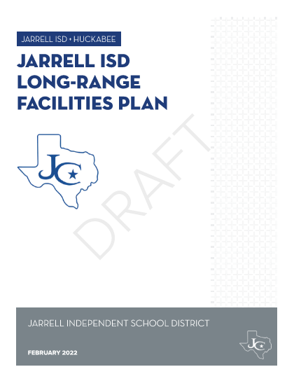
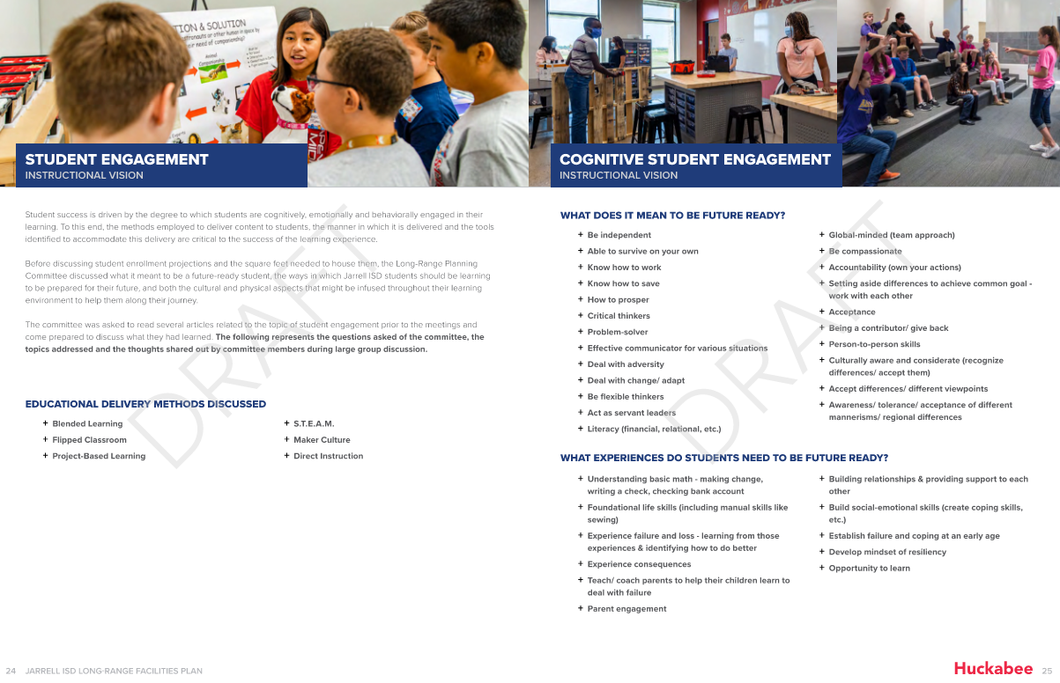
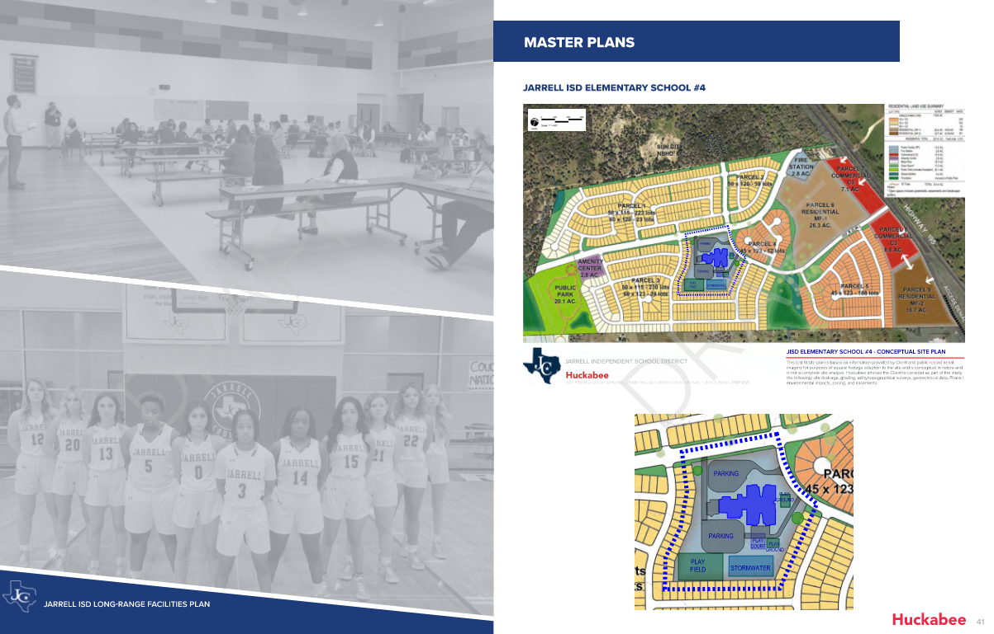
Long Range Planning Committee
Met from 2020 through 2021
COVID break...
Developed forward thinking plans for:
  Growth
  Learners
  Schools
  Communities

Slide 28
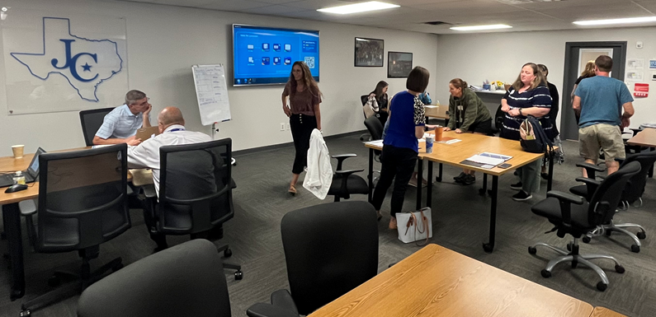
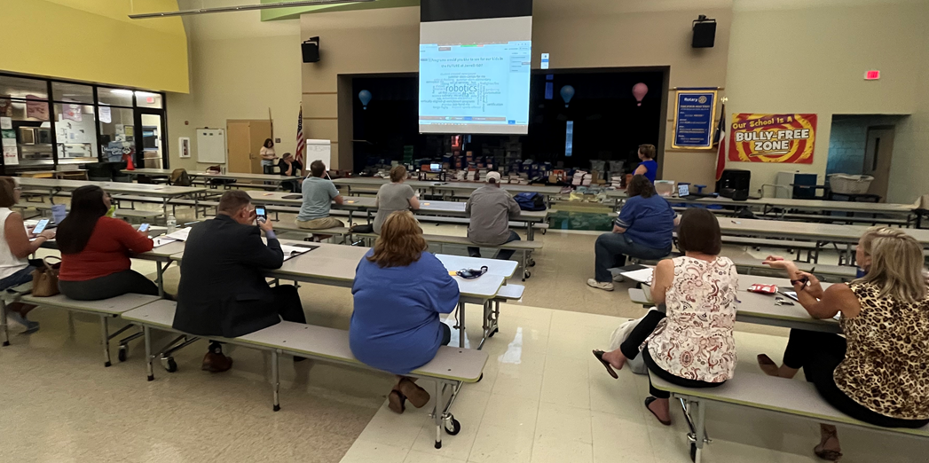
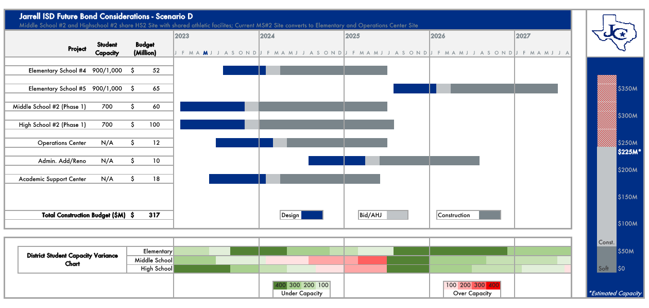
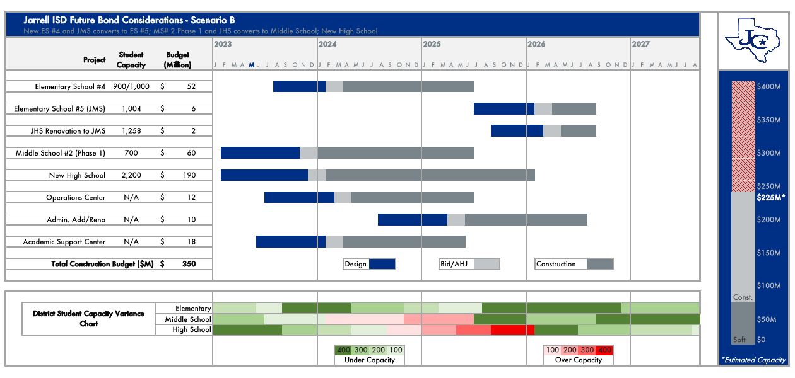
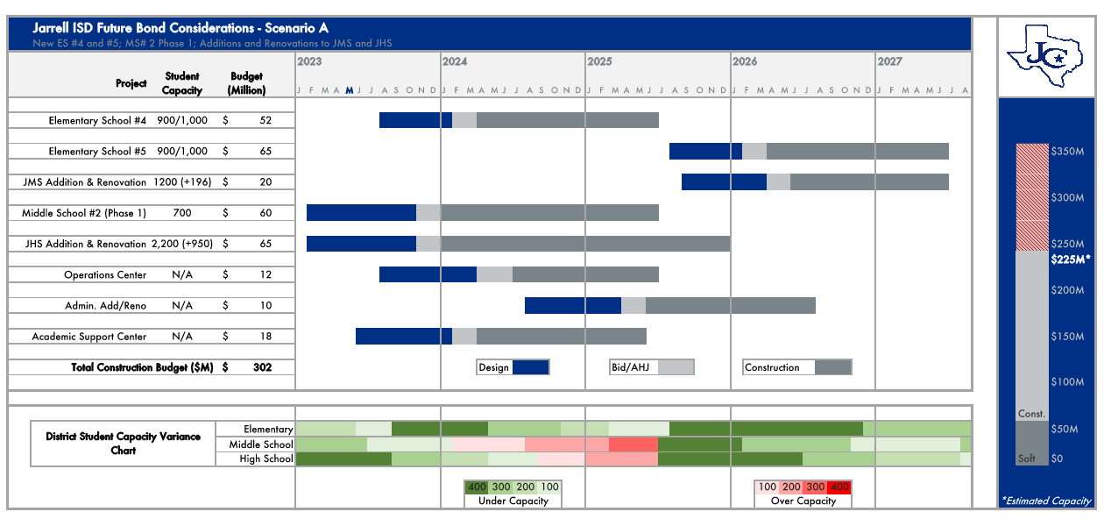
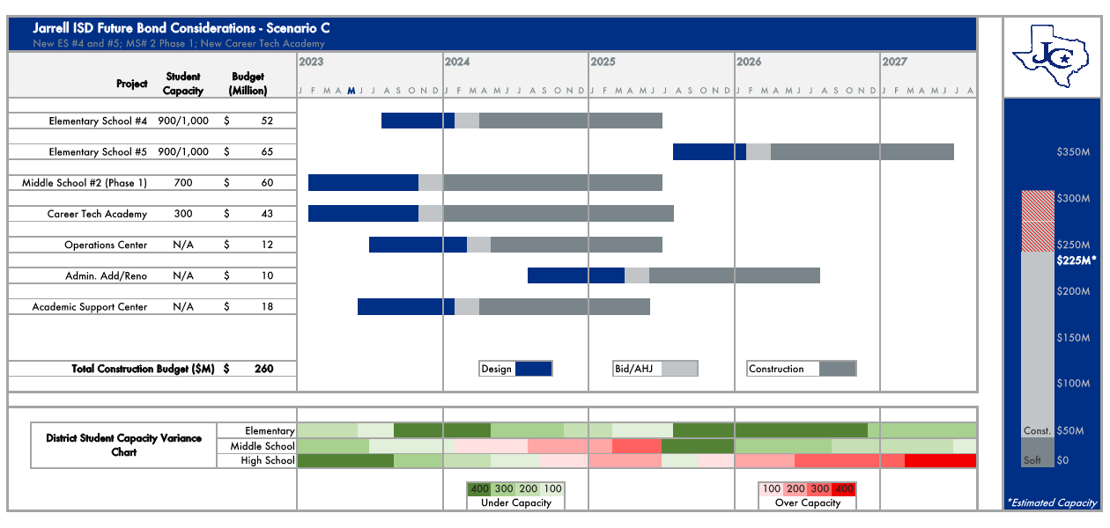
Facilities Planning Committee
Monthly meetings from March 2022 through September 2022
Reviewed demographics, existing campus capacities & future growth needs.
Explored various facility types and scenarios
Recommended facility types and capacity

Slide 29
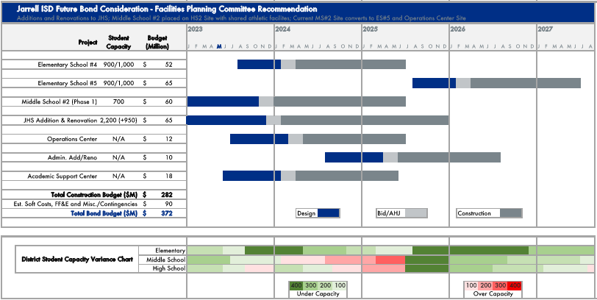
Facilities Planning Committee

Slide 30
Group Feedback

Slide 31
At your table, discuss:
Anything that stands out
Any questions you have
Your general opinions of what you have heard so far
Things you need more information on
Choose one spokesperson to share your table’s main takeaways with the rest of the large group.
*Use the notecards provided at your table to write down any additional questions/comments you want the district to follow up on.

Slide 32
Looking ahead…
Next meeting: Thursday, November 10 at Jarrell Middle School
Light food begins at 5:30 and meeting begins promptly at 6pm.
Our discussion will include:
  The Committee’s Definition of Consensus
  School Finance 101 & JISD Financial Overview
  Building Total Project Budgets/Construction Costs Overview
  Scenarios/Potential Projects with Cost Analysis

Slide 33
Thank you!
The optional campus tour will begin in 5 minutes.

