Slide 1




Slide 2

School Facilities
Land
Safety
Technology
Buses
Totaling: $324,607,052

Slide 3
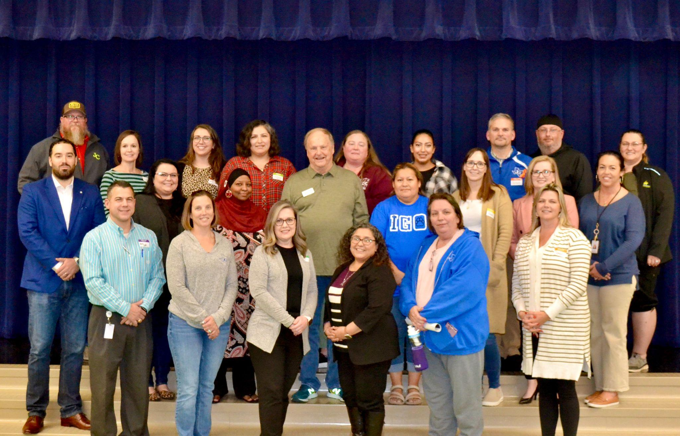
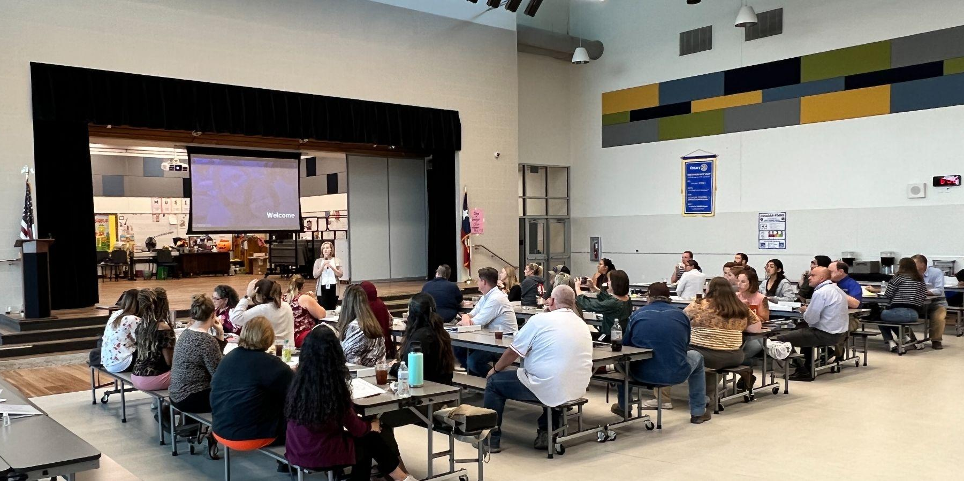
Pre-Bond Committee
More than 50 citizens were invited to join this committee.
Committee Members were included to ensure a diverse cross-section of the JISD community:
  Parents & Non-Parents
  Campus & District Staff
  Community & Business
  Mix of Backgrounds & Geographic Representation
Including varying perspectives was important to ensure all students were considered.

Slide 4
Key Information Studied
Jarrell ISD and the Pre-Bond Committee studied:
Findings from Previous Committees
Demographic Report and Enrollment Projections
School Finance (state and local)
Bonding Capacity & Impact of Potential Bond
Needs, Potential Solutions & Cost Analysis
  New Construction
  Renovations
  Expansions
  Special Programs/Facilities
  Safety & Security
  Technology
  Transportation
  Land

Slide 5
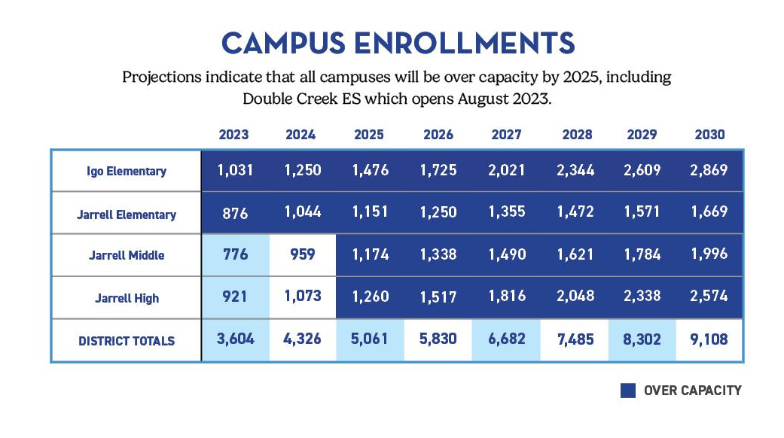

Slide 6
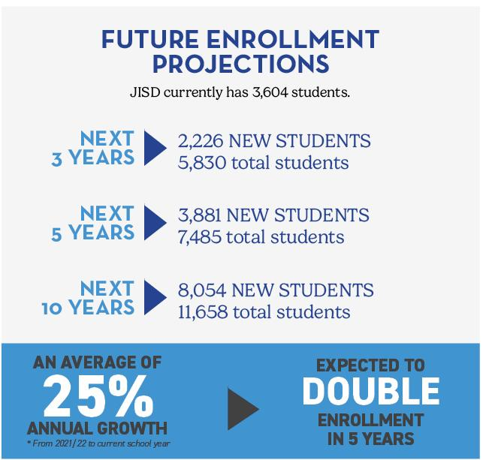
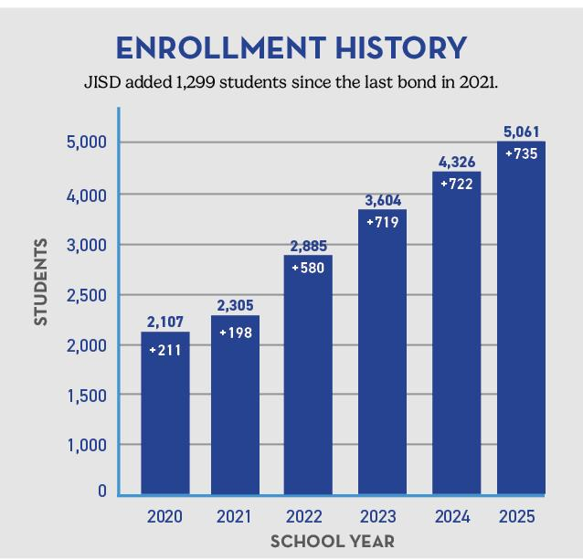

Slide 7
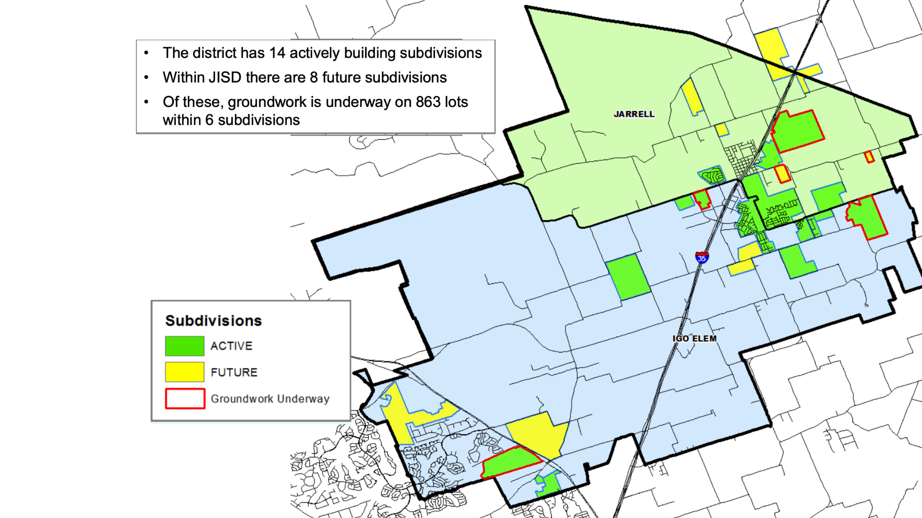
December 2022

Slide 8
Elementary School #4
Bond Proposal
New school for 900 students opening 2025
Addresses capacity needs through 2026/2027 school year
Elementary School #5
New school for 900 students opening 2027
Open August Addresses capacity needs through 2028/2029 school year
New Middle School #2
New school for 700 students (phase 1) opening 2025
Utilizes existing JISD owned land
Addresses capacity needs through 2027/2028 school year

Slide 9
Jarrell High School Additions & Renovations
Increase student capacity to 2,200 students (+942 students)
Includes:
  General Classrooms
  Dedicated Career Technical Education (CTE) Wing
  New Competition Gym and Locker Rooms
  Ag Barn Expansion
  Fine Arts Addition
  High School Office & Library Expansion
Approx. 160,000 sq.ft.
Complete December 2025
Addresses capacity needs through 2028/2029 school year

Slide 10
District Operations Center
Creates single dedicated facility, separate from a student campus
District Maintenance Facility
Transportation Center
  Multiple maintenance bays
  Fueling station
Utilizes existing JISD owned land
Open August 2025
Notes:
16 new buses and 8 new white fleet vehicles.

Slide 11
Buses and White Fleet
Safety and Security
16 new buses and 8 new white fleet
Land (Property and Infrastructure)
Access Controls and security cameras
Technology
District-wide infrastructure improvements
Child Development Center
Update Paw Prints Facility and/or Relocate

Slide 12
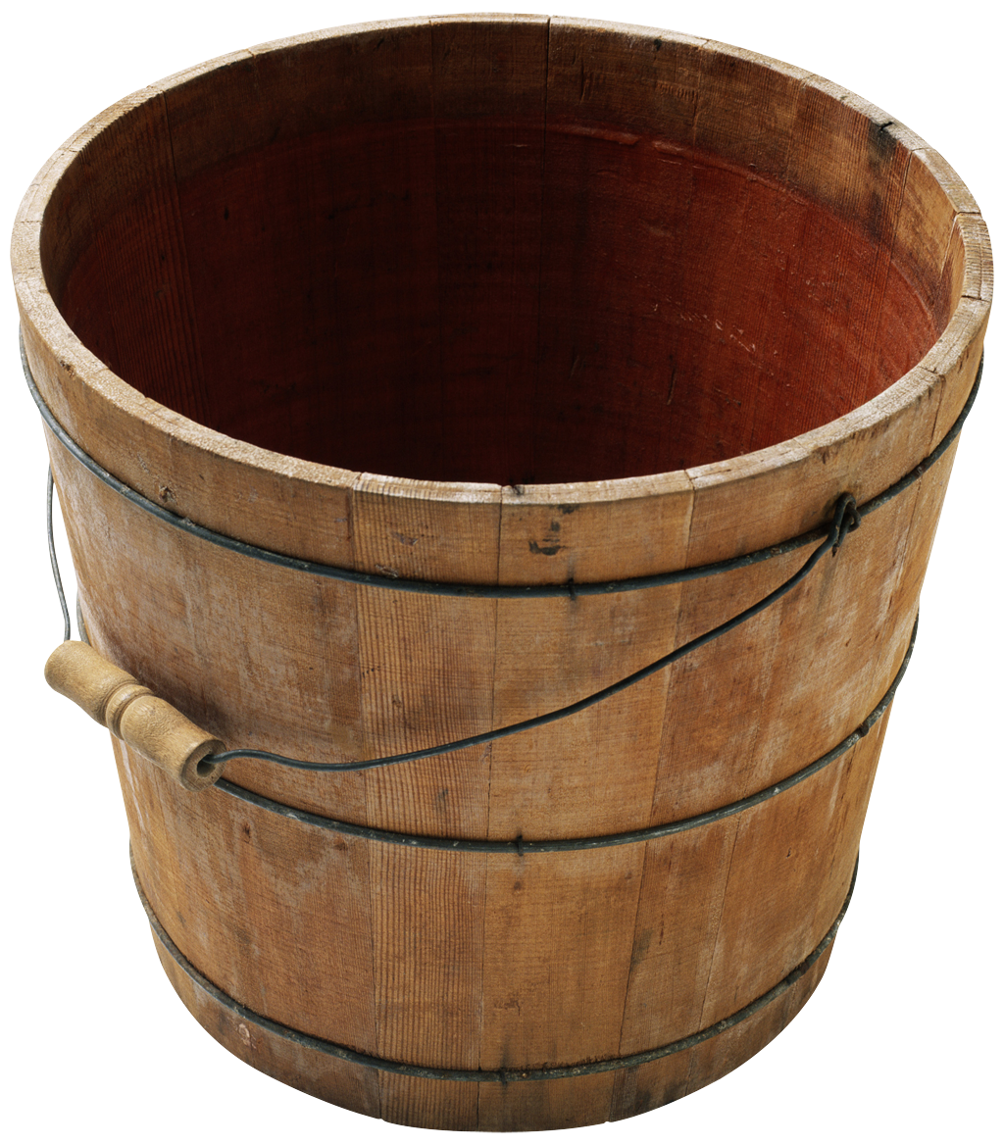
School Finance
Each year, a school district adopts two tax rates, which determine the total tax rate:
M&O
I&S
  Maintenance & Operations
  (M&O – aka general fund)
  Interest & Sinking
  (I&S – aka debt service)

Slide 13
Maintenance & Operations (M&O) Tax Rate
Funds the day-to-day maintenance and operations of the district:
Salaries (for teachers and other staff)
Bus repairs, maintenance and fuel
School supplies and materials
Utilities (electricity, water, etc.)
For the average citizen
this is similar to:
  House repairs
  Car fuel
  Routine services
  Groceries
  Cleaning Supplies
  Utilities
FY 22-23 M&O Tax Rate
is $0.8546 per $100
of property value.
Notes:
If a district wants to raise the rate beyond the cap, it requires voter approval through the holding of a
Voter-Approval Tax Rate Election.

Slide 14
Interest & Sinking (I&S) Tax Rate
Funds debt repayment for all bonds issue. Items include:
New building construction
Existing building renovations
Land purchases
Program-specific equipment
Technology
School buses
For the average citizen
this is similar to:
  New home purchase
  House renovations
  Land for a home
  New appliances
  New home computer
  New car
FY 22-23 I&S Tax Rate
is $0.50 per $100
of property value.
Notes:
By law, this cannot exceed $0.50.

Slide 15
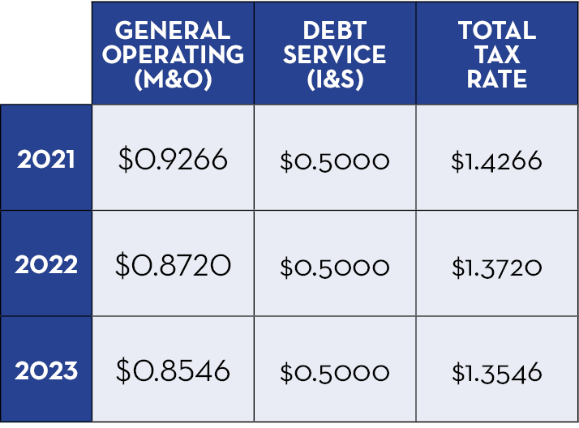
Tax Rate History
The district’s overall tax rate has been reduced over the last three years.
If approved by voters, this bond will not increase the district’s tax rate.

Slide 16
Homeowners Over 65
Homeowners over the age of 65 who have filed their Homestead Exemption have frozen taxes, meaning the amount of taxes they pay will not increase, regardless of a bond election.
Important Note
JISD does not set your property values, only the school district tax rate. Your property values are determined by the Williamson County Appraisal District.

Slide 17
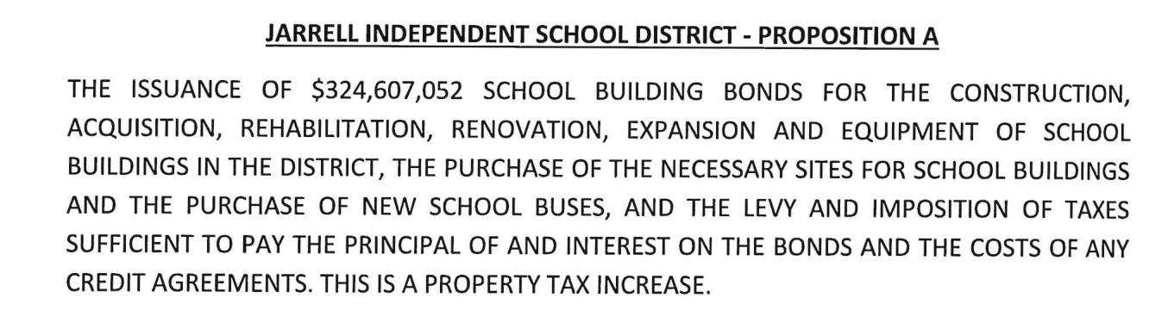
Ballot Language
In compliance with a new state law, all bond propositions in Texas must include the following statement on the ballot: “THIS IS A PROPERTY TAX INCREASE.” However, if approved by voters, this bond will not increase your district tax rate.
Voters will see this legally required statement in the official ballot language on all bond propositions, even when there is NO tax rate increase proposed in connection with the bond election.

Slide 18
Bond Proposal Review | Total Cost Estimate
Elementary School #4 (Aug '25 Open) (900 student capacity) | $48,493,509
Elementary School #5 (Aug '27 Open) (900 student capacity) | $55,114,229
New Middle School #2 (Phase 1 – 700 student capacity) | $89,371,249
JHS Additions & Renovations (2,200 student capacity) - CTE, General Classrooms, Ag Barn, Gymnasium, Fine Arts | $92,591,479
Paw Prints Facility | $6,384,819
District Operations Center - Transportation Center, Fueling Station and Maintenance Facility | $17,333,937
Technology Infrastructure | $1,371,858
Security | $945,972
Land (Property and Infrastructure) | $10,000,000
Buses and White Fleet | $3,000,000
TOTAL ESTIMATED COST | $324,607,052

Slide 19
Next Steps
Deadline to Register to Vote: Thursday, April 6
Early Voting: Monday, April 24 – Tuesday, May 2
Election Day: Saturday, May 6
Register to vote with Williamson County or find out if you are already registered at Wilco.org.
Questions or comments:
Email: communications@jarrellisd.org

Slide 20

Learn more at
jarrellisd.org/bond2023

